Slide 1


Making eTheses USEFUL
Peter Murray-Rust*,
University of Cambridge and OKF
ETD2014, Leicester, UK 2014-07-24
*Shuttleworth Fellow 2014-5
Notes:
Hi, I’m here to talk about AMI; a data extraction framework and tool. First, I just want highlight some of key contributors to the projects; Andy for his work on the ChemistryVisitor and Peter for the overall architecture.
In this talk, I’m going to impress the importance of data in a specific format and its utility to automated machine processing. Then I’m going to demonstrate AMI’s architecture and the transformation of data as it flows through the process. I’m going to dwell a little on a core format used, Scalable Vector Graphics (SVG) before introducing the concept of visitors, which are pluggable context specific data extractors. Next, I’m going to introduce Andy’s ChemVisitor, for extracting semantic chemistry data, along with a few other visitors that can process non-chemistry specific data. Finally, I will demonstrate some uses of the ChemVisitor, within the realm of validation and metabolism.

Slide 2
Overview
We waste > 10,000,000,000 USD of eThesis value*
Everyone else is becoming OPEN; not Universities
What we CAN DO NOW: ContentMining
What we SHOULD do: Open Notebook Science
We don’t need commercial organisations to manage theses.
The time has come; We can do it now
*My numbers are DEBATABLE! Please add your thoughts to http://pads.cottagelabs.com/p/etd2014 or tweet #etd2014

Slide 3
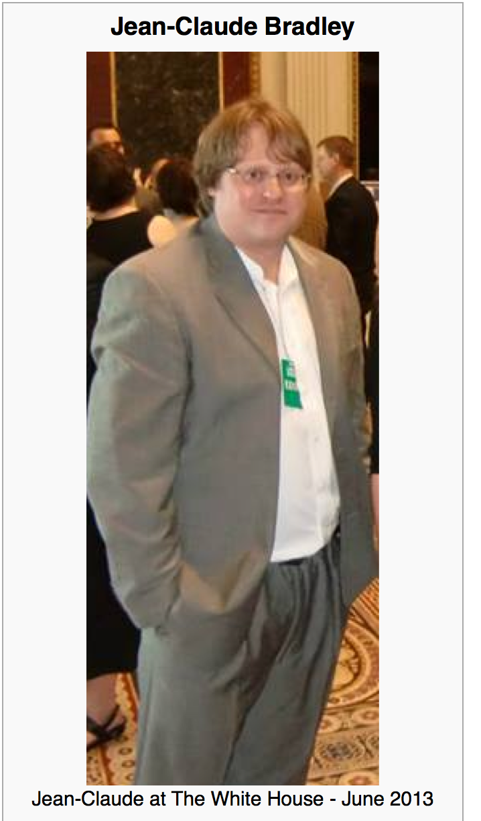

Jean-Claude Bradley
Jean-Claude Bradley was one of the most influential open scientists of our time. He was an innovator in all that he did, from Open Education to bleeding edge Open Science; in 2006, he coined the phrase Open Notebook Science. His loss is felt deeply by friends and colleagues around the world.
On Monday July 14, 2014 we gathered at Cambridge University to honour his memory and the legacy he leaves behind with a highly distinguished set of invited speakers to revisit and build upon the ideas which inspired and defined his life’s work.
Wikipedia CC BY-SA
Notes:
Hi, I’m here to talk about AMI; a data extraction framework and tool. First, I just want highlight some of key contributors to the projects; Andy for his work on the ChemistryVisitor and Peter for the overall architecture.
In this talk, I’m going to impress the importance of data in a specific format and its utility to automated machine processing. Then I’m going to demonstrate AMI’s architecture and the transformation of data as it flows through the process. I’m going to dwell a little on a core format used, Scalable Vector Graphics (SVG) before introducing the concept of visitors, which are pluggable context specific data extractors. Next, I’m going to introduce Andy’s ChemVisitor, for extracting semantic chemistry data, along with a few other visitors that can process non-chemistry specific data. Finally, I will demonstrate some uses of the ChemVisitor, within the realm of validation and metabolism.

Slide 4
The cost and value

Slide 5
The economic value of data
I believe that we spend globally ca 400 billion USD / yr on public research.
The outputs include:
Knowledge / papers / patents
Organizations
People
Materials
Data – many billions/year and much is lost

Slide 6
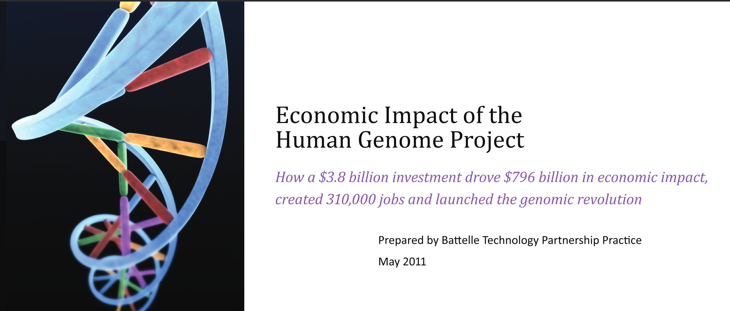
US Taxpayers spend 139 Billion USD / yr
on Scientific Research
4 Billion USD on human genome
yielded 800 Billion USD and 4 M job-years

Slide 7
Scholarly publication
Citizens pay $400,000,000,000…
… for research in 1,500,000 articles …
… cost $300,000 each to create …
… $7000 each to “publish” … ($7 USD arXiv)
… costs $10,000,000,000 …
… “publishers” forbid access to 99.9% of citizens of the world …
… Value???
Please challenge these numbers… #etd2014 or http://pads.cottagelabs.com/p/etd2014

Slide 8
Bad publication wastes science
…three problems—flawed design, non-publication, and poor reporting—together meant >85% of research funds were wasted, a global total loss >100 billion USD per year. [Lancet 2009]
[Even more] waste clearly occurs after publication: from poor access, poor dissemination, and poor uptake of the findings of research. [PLOS Medicine 2014-05-27]

Slide 9
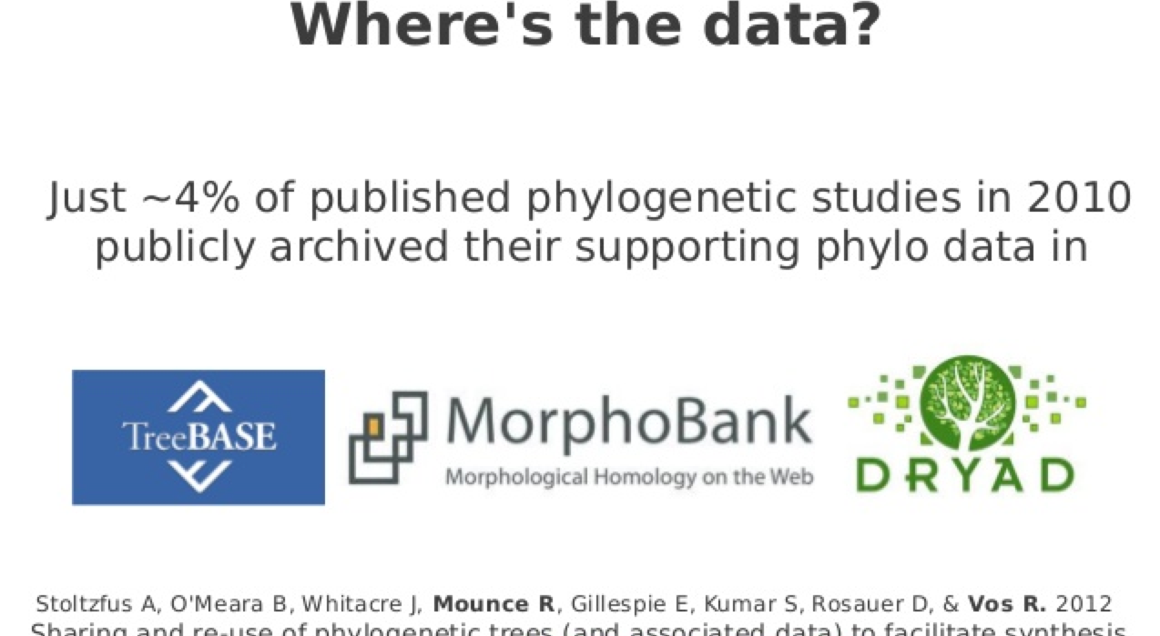
Authors don’t deposit data (Ross Mounce)

Slide 10
Where is the Digital Enlightenment?
Science is done in C20th ways …
…communicated in C19th ways …
… losing the power of C21st

Slide 11
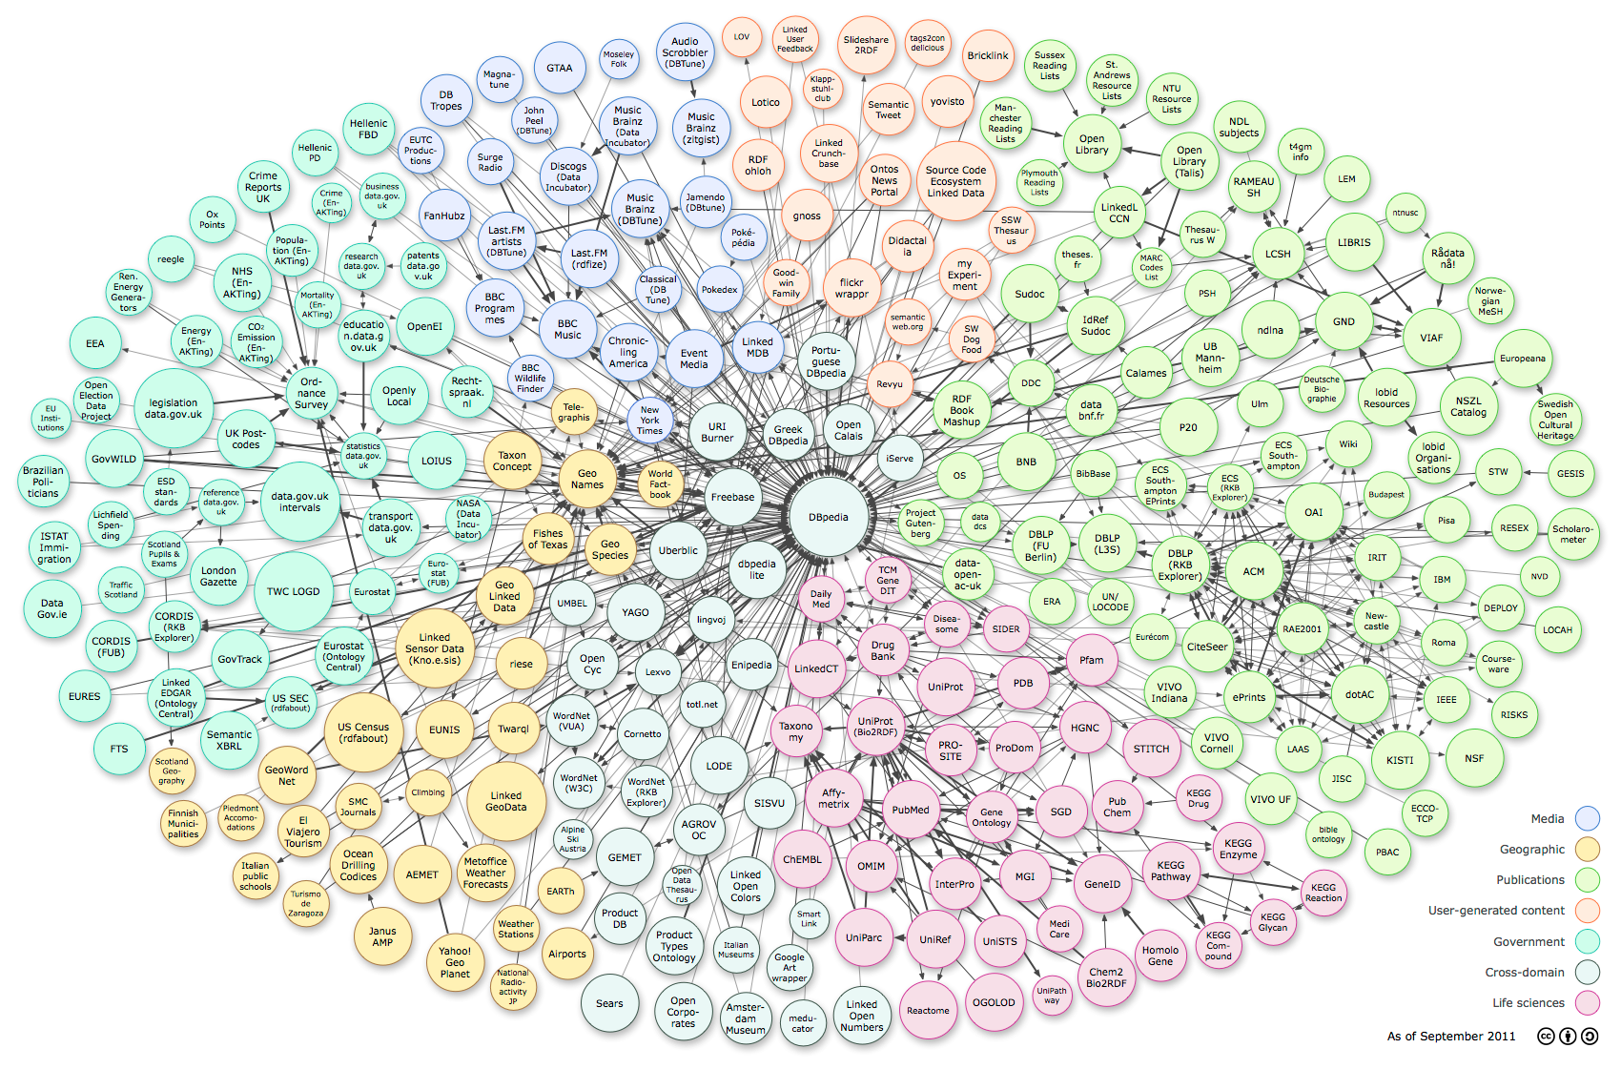
Linked Open Data – the world’s knowledge
RDF
triples
Music,
Art
Literature
Social
DBPedia
Knowledge
bases
Lib
GOV.uk
Comp
PDB
GOV
BIO
Ontologies
very little physical science and THESES?? ☹
http://upload.wikimedia.org/wikipedia/commons/3/34/LOD_Cloud_Diagram_as_of_September_2011.png

Slide 12
eTheses
Citizens pay $20,000,000,000*…
… for research in 200,000 science theses*…
… cost $100,000 each to create* …
… re-use ??? (near zero)
… Value???
*Please challenge these numbers…
NOTE: we pay publishers $15,000,000,000 for journals and APCs

Slide 13
“Free” and “Open”
"Free software is a matter of liberty, not price. ’free speech', not 'free beer'”. (R M Stallman)
“A piece of data or content is open if anyone is free to use, reuse, and redistribute it” (OKFN)http://opendefinition.org/
“open” (access) has multiple incompatible “definitions”. Major split is “human eyeballs” vs copying and machine “reusability”
“Open” is a marketing term for publishers, who frequently (often deliberately) do not grant full Openness.
“Gratis” vs “Libre”

Slide 14
Critical Historical Open Events
Free Software Foundation (RMS, 1985) and Linux (Torvalds, 1991)
The World Wide Web (TBL, 1991)
The human genome (1990-2001)
The life of Aaron Swarz (1986-2013)

Slide 15
https://en.wikipedia.org/wiki/Bermuda_Principles
Automatic release of sequence assemblies larger than 1 kb (preferably within 24 hours).
Immediate publication of finished annotated sequences.
Aim to make the entire sequence freely available in the public domain for both research and development in order to maximise benefits to society.

Slide 16
http://www.budapestopenaccessinitiative.org/read
… an unprecedented public good. …
… completely free and unrestricted access to [peer-reviewed literature] by all scientists, scholars, teachers, students, and other curious minds. …
…Removing access barriers to this literature will accelerate research, enrich education, share the learning of the rich with the poor and the poor with the rich, make this literature as useful as it can be, and lay the foundation for uniting humanity in a common intellectual conversation and quest for knowledge.
(Budapest Open Access Initiative, 2003)

Slide 17
Panton Principles for Open Data in science(2010)
PUBLISH YOUR DATA OPENLY
…make an explicit and robust statement of your wishes.
Use a recognized waiver or license that is appropriate for data.
open as defined by the Open Knowledge/Data Definition (… NOT non-commercial)
Explicit dedication of data … into the public domain via PDDL or CCZero
Peter Murray-Rust, Cameron Neylon, Rufus Pollock, John Wilbanks

Slide 18
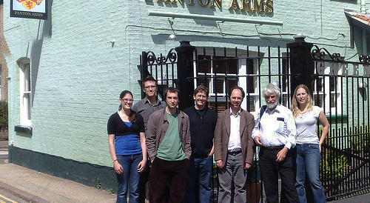
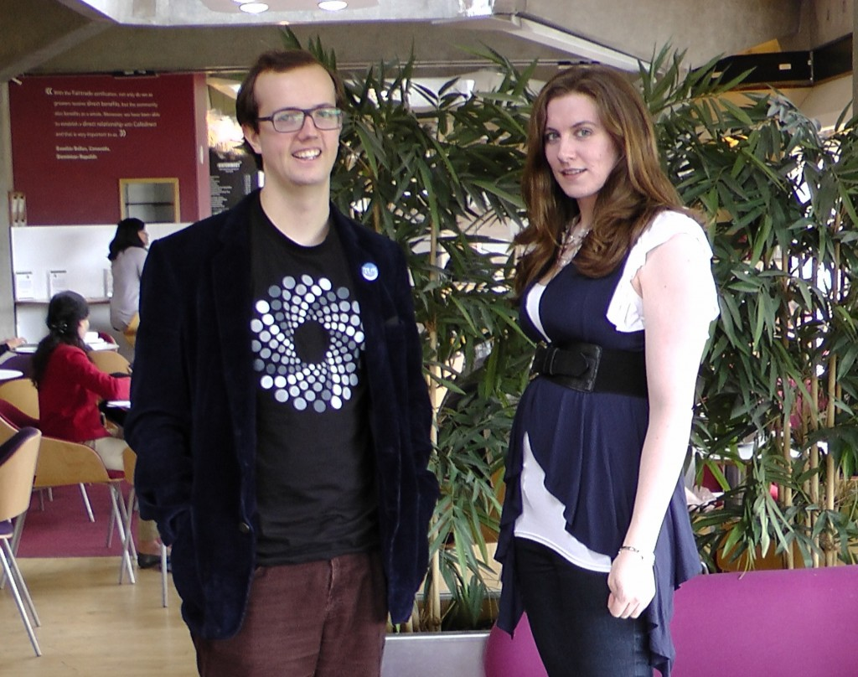
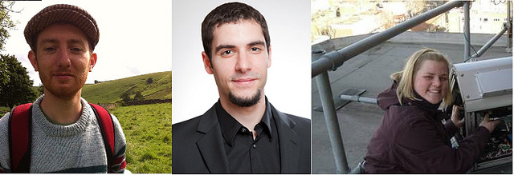
Panton Authors and Fellows

Slide 19
Problems of Commercial

Slide 20
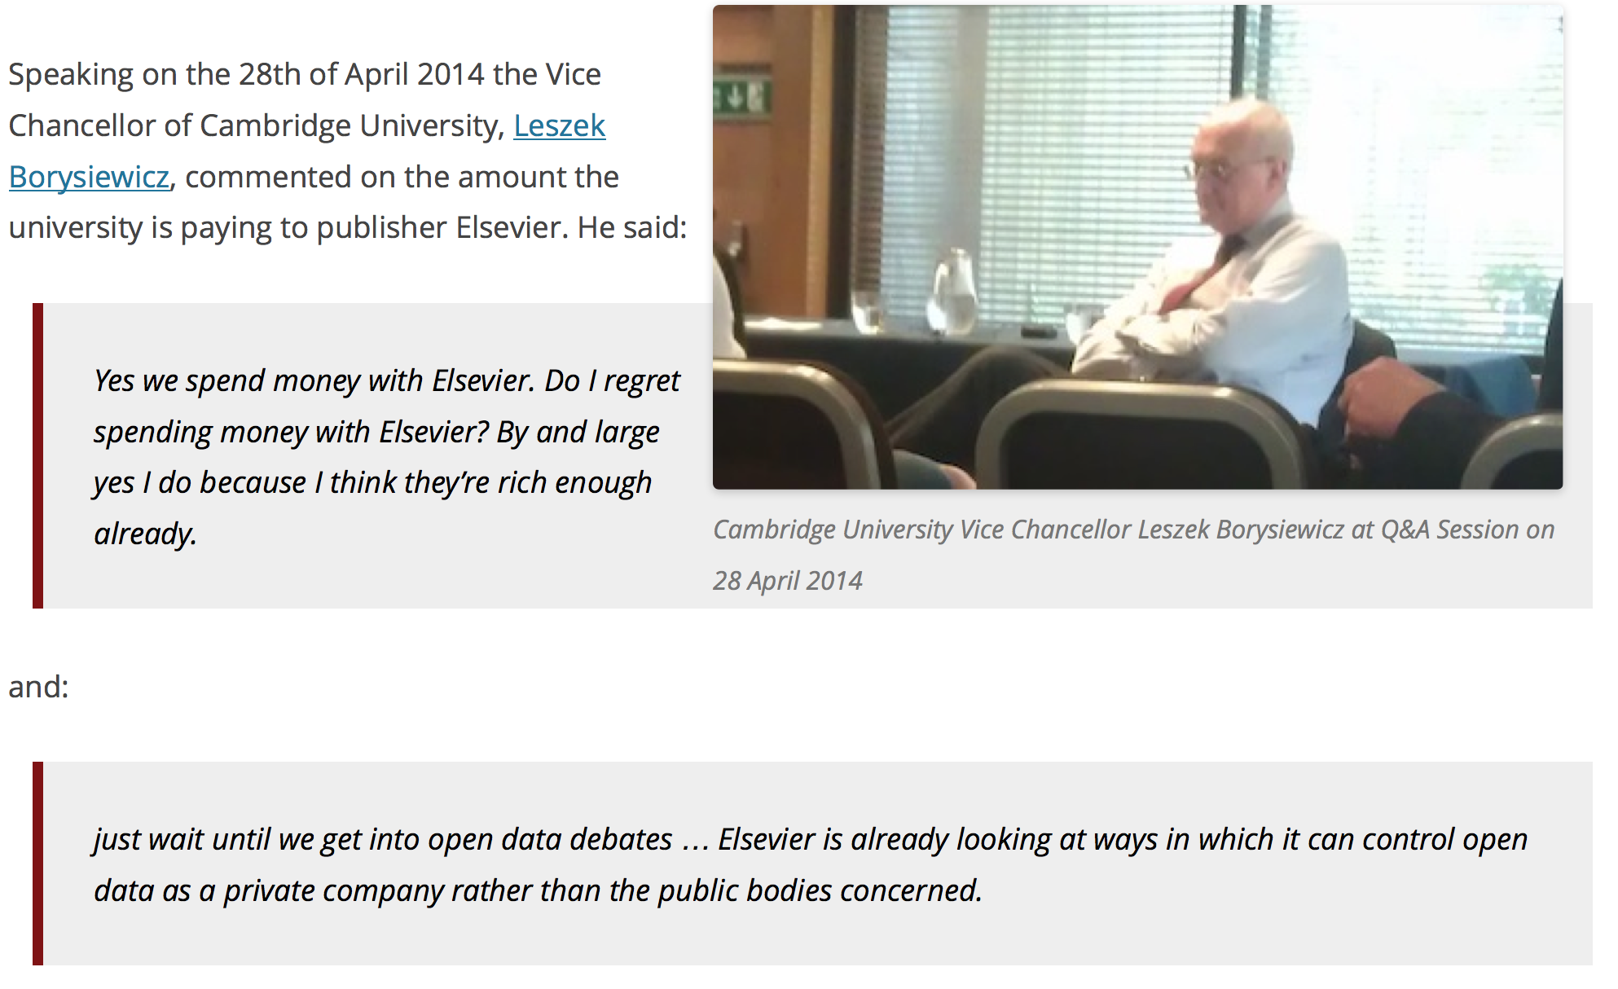
Elsevier wants to control Open Data
[asked by Michelle Brook]

Slide 21
Mendeley From Wikipedia, the free encyclopedia
… a social media site used by many scientists to store metadata …
… purchased by Elsevier in 2013
David Dobbs, in The New Yorker, described motive as:
to acquire its user data,
to destroy or coöpt an open-science icon that threatens its business model.
PM-R: Mendeley can also Snoop and Control

Slide 22
New ways for Theses
Content Mining
Open Notebook Theses

Slide 23
Traditional Research and Publication
DATA
???
rewrite
“Lab” work
Write
paper/thesis
publish
Validation??
output often
seriously restricted
Re-experiment

Slide 24
Content-Mining (TDM)
Now COMPLETELY LEGAL IN UK since 2014-06-01 …
… Whatever the publishers tell you. Do NOT sign their APIs
Contentmine.org …
… sponsored by Shuttleworth Foundation …
… to extract 100,000,000 facts from scientific literature
And STM publishers are throwing millions to stop us

Slide 25
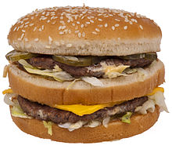
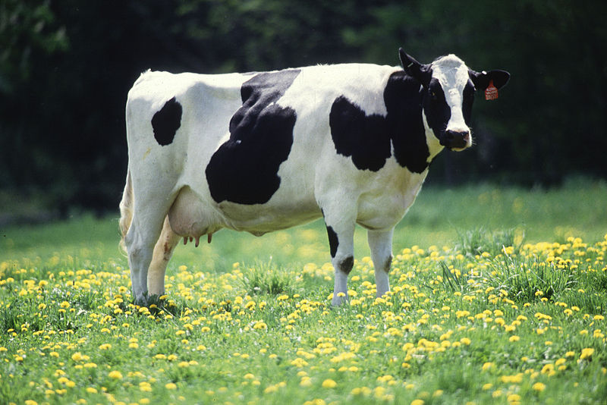
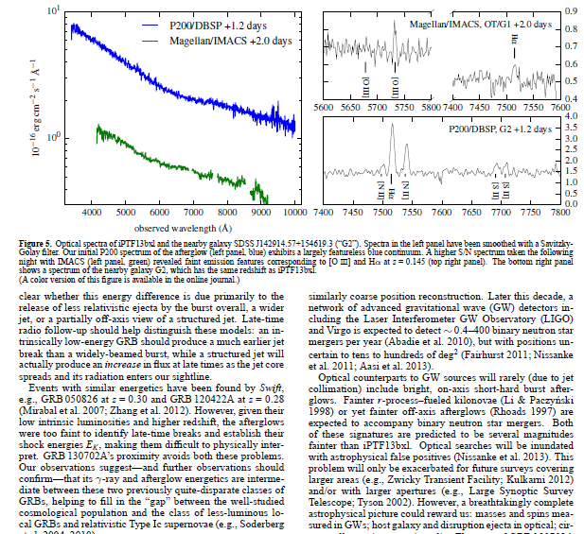
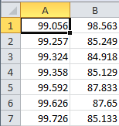
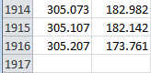
But we can now turn PDFs into Science
We can’t turn a hamburger into a cow

Slide 26
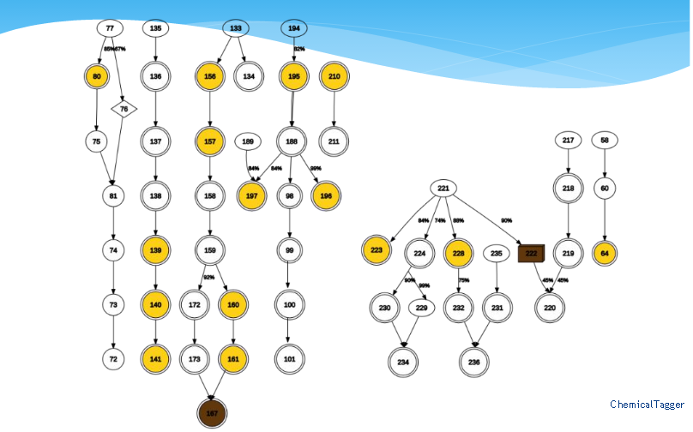
How a machine reads a chemical thesis
nodes are compounds; arrows are reactions

Slide 27
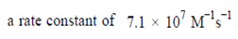


PROPERTIES (Name-Value-Units-Error)
Name
Value
Units
V
U
N
V
U
N
N
V
E
U
N
V
E
U

Slide 28
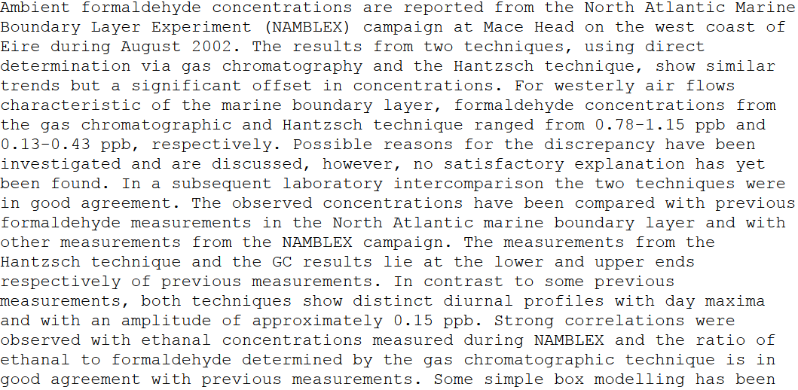
“nuggets” in a scientific paper
places
project
Value ranges
quantity
units
chemical
Humans aren’t designed to mine this … ☹

Slide 29
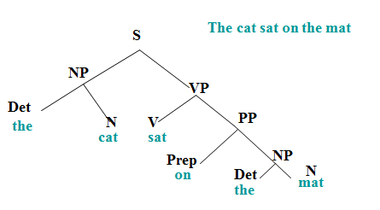
Natural Language Processing
Part of speech tagging (Wordnet, Brown Corpus, etc.)

Slide 30

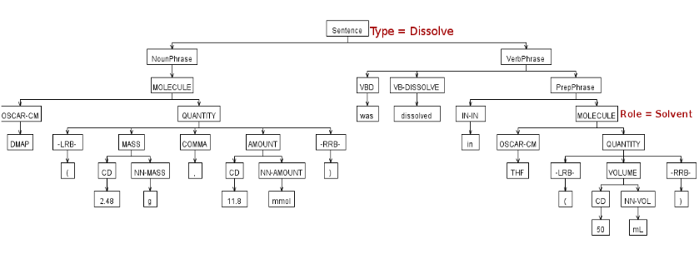
Parsing chemical sentences

Slide 31
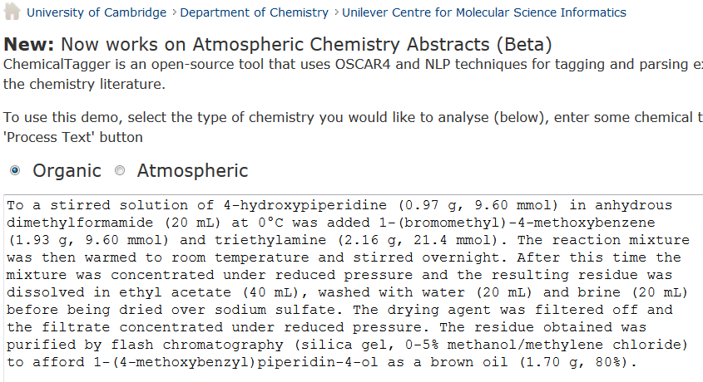
http://wwmm.ch.cam.ac.uk/chemicaltagger
Typical
Typical chemical synthesis

Slide 32
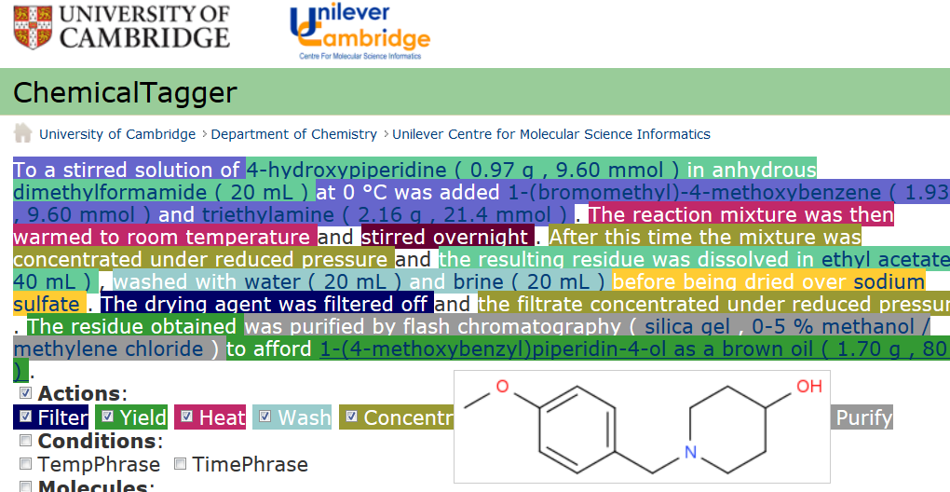
Automatic semantic markup of chemistry
Could be used for analytical, crystallization, etc.

Slide 33
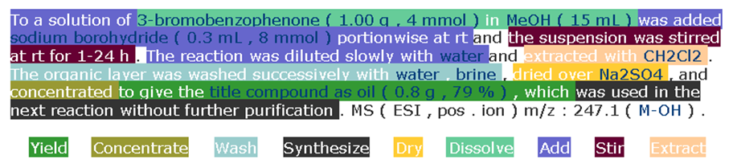
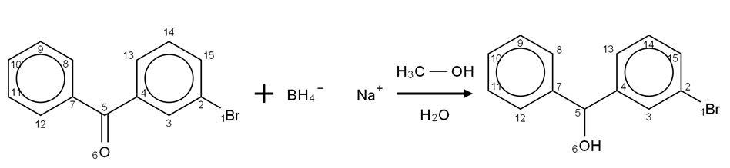
Open Content Mining of FACTs
Machines can interpret chemical reactions
We have done 500,000 patents. There are > 3,000,000 reactions/year. Added value > 1B Eur.

Slide 34
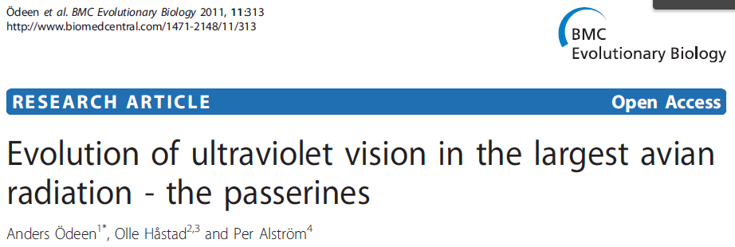
PDF ☹
AMI
HTML ☺
Evolution of ultraviolet vision in the largest avian radiation - the passerines
Anders Ödeen ^{1*} , Olle Håstad ^{2,3} and Per Alström ⁴
Styles , ^{superscripts}
And diåcritics
preserved!

Slide 35
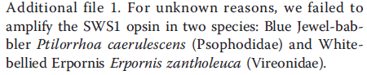
PDF ☹
Turdus iliacus
Taeniopygia guttata
Serinus canaria
Lanius excubitor
Melopsittacus undulatus
Pavo cristatus
Sturnus vulgaris
Dolichonyx oryzivorus
Ficedula hypoleuca
Vaccinium myrtillus
Falco tinnunculus
Turdus
Pomatostomus
Leothrix
Amytornis
Acanthisitta
Orthonyx x 2
Malurus
Cnemophilus x 4
Philesturnus x 2
Motacilla x 2
Toxorhampus x 2

Slide 36
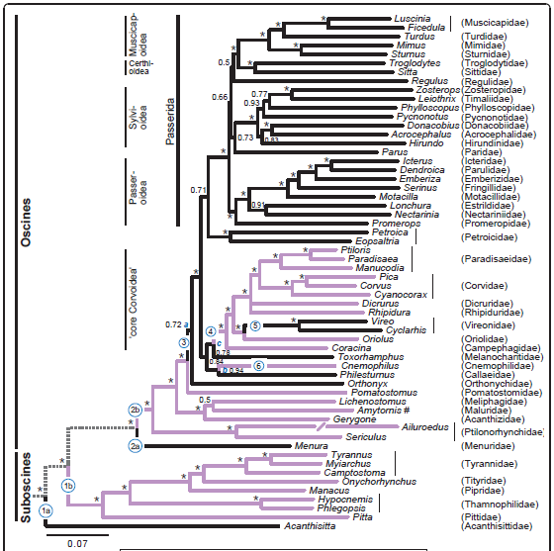
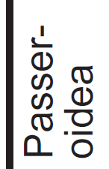
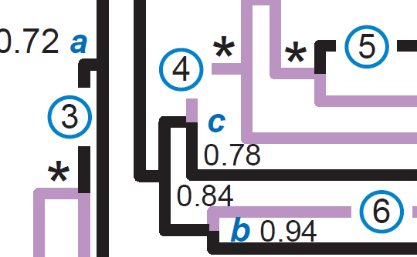
Typical phylo tree: 60 nodes, complex and miniscule annotation,
vertical text, hyphenation and valuable branch lengths. AMI extracts ALL

Slide 37
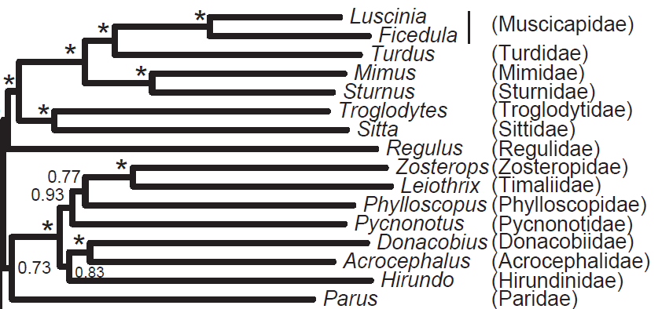
AMI
Acanthisittidae
Acanthizidae
Acrocephalidae
Callaeidae
Campephagidae
Cnemophilidae
Corvidae
Acanthisitta
Acrocephalus
Ailuroedus
Ailuroedus
Amytornis
Camptostoma
0.84
0.91
0.93
0.95
23.12
34.54
37.21
38.55
NexML
HTML
Posterior
probability
AMI can MEASURE
Branch lengths!
Genus
Family

Slide 38
Open Notebook Science
Graduate students understand it: do you?

Slide 39
Free/Open Software Development
validate
Engineered repository
CODE
rewrite
fork
CODE
Re-use
inspires
Re-use
CODE
CODE
OSI
World
community
Github, BitBucket
StackOverflow,
Apache
Example: ContentMine at
http://github.com/ContentMine/quickscrape

Slide 40
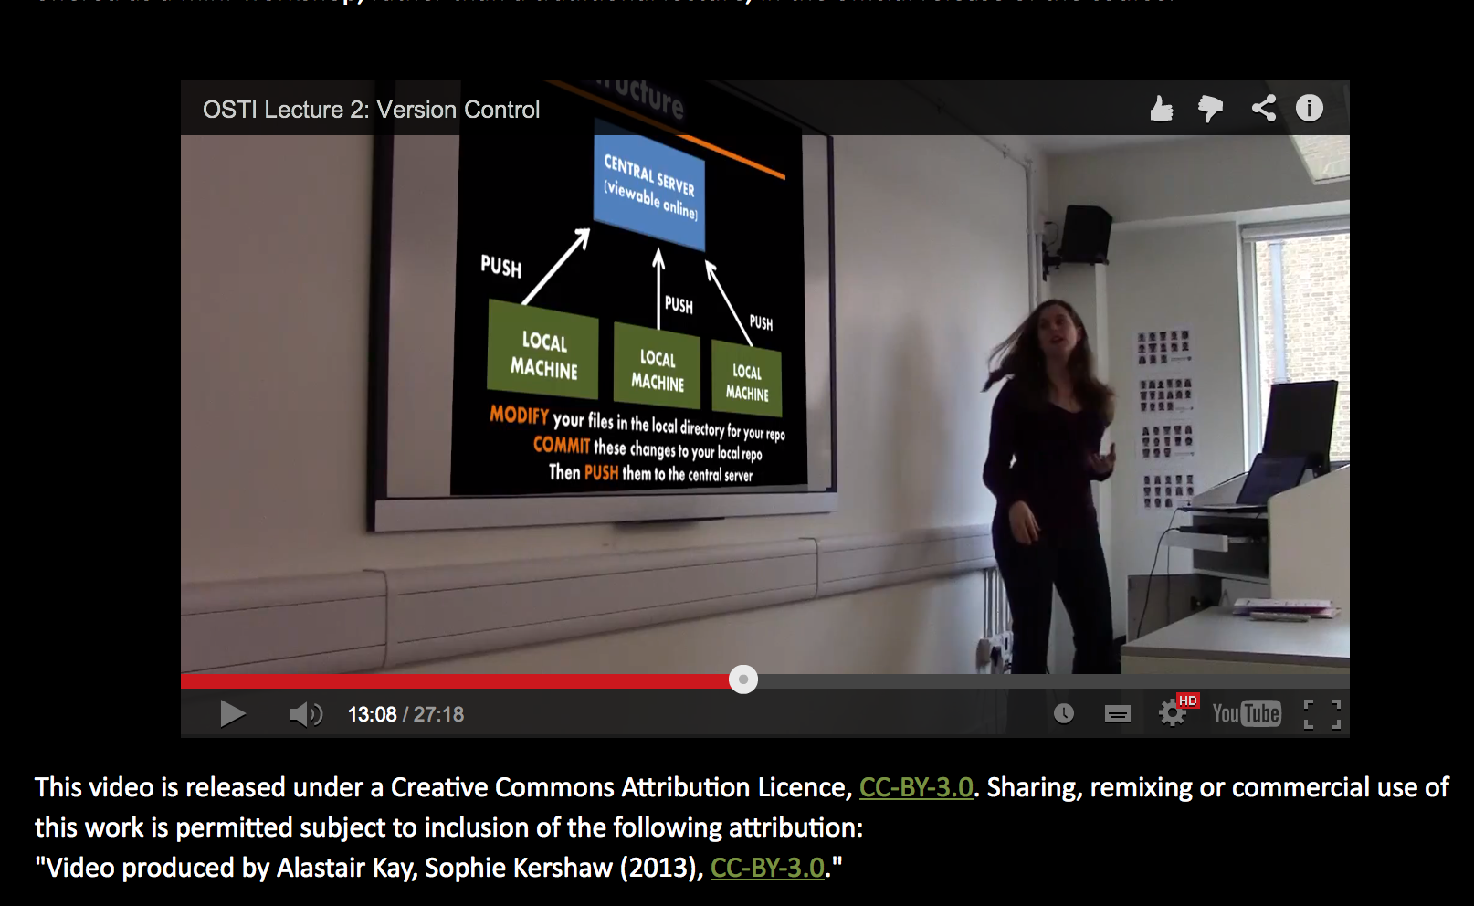
Sophie Kershaw, Panton Fellow, Training PhD Students

Slide 41
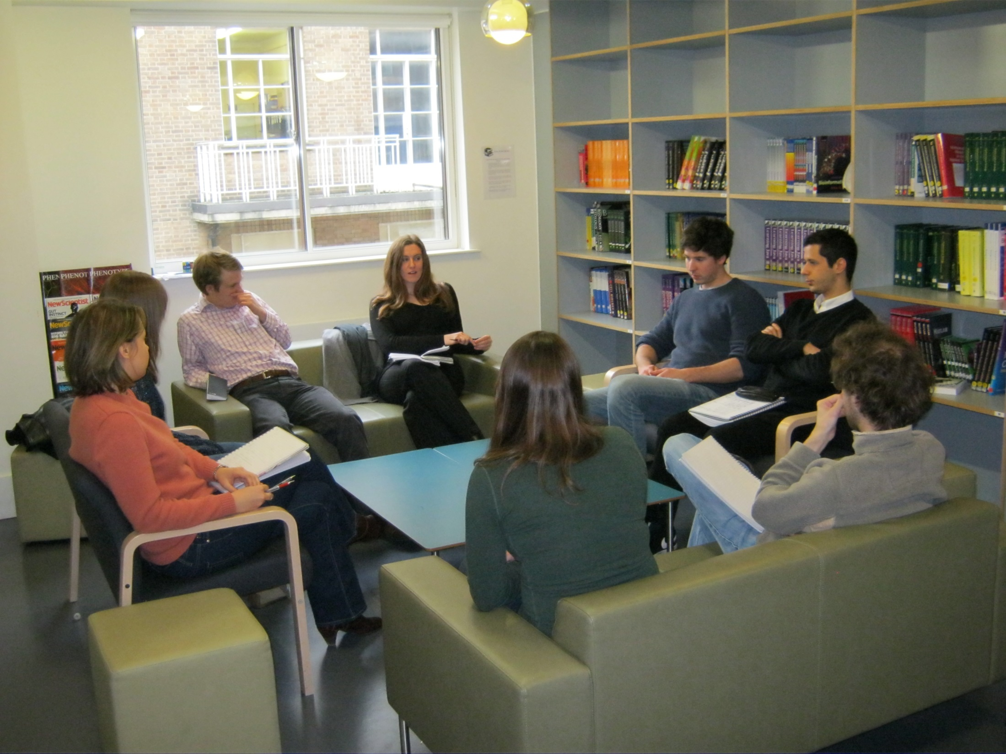
“Do you think you would be more confident in the future about trying to apply Open techniques to your work..?”
50% Yes, by myself
41% Yes, with help/guidance
9% No opinion/neutral
0% No

Slide 42
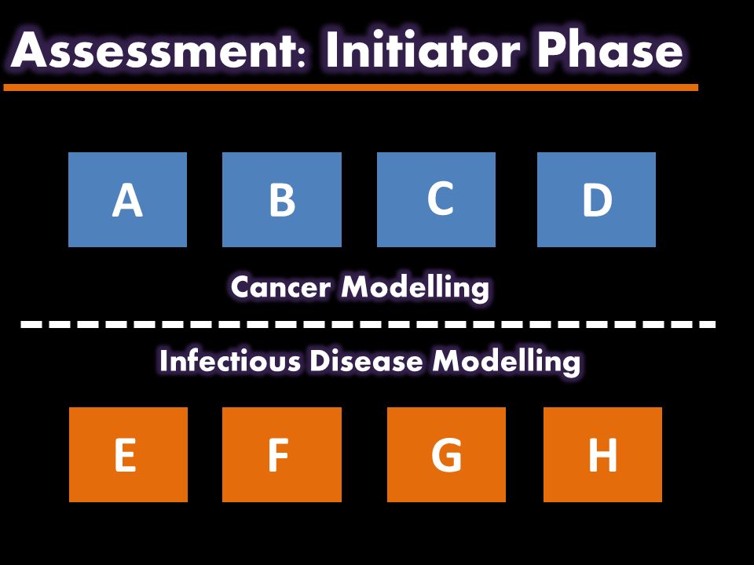
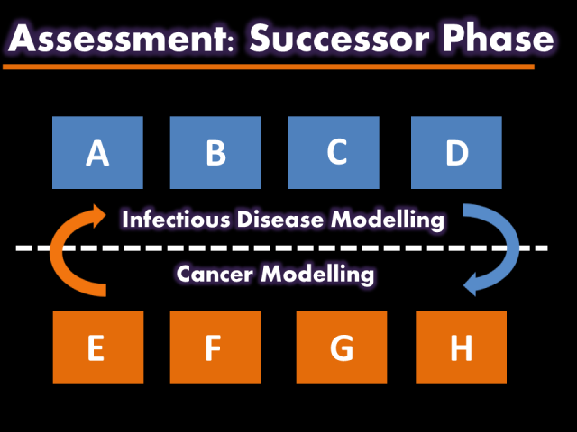
Rotation-Based Learning (RBL)
Role of research producer vs. research user
Can this approach help to foster awareness of reproducibility issues?
Phase 1: Initiator
No communication permitted between groups
Attempt to reproduce existing literature
Deliver a coherent research story by the end of Phase 1
Throughout Phases 1 & 2:
Daily lectures on open science culture & techniques
First-hand application to own research work
Version control using GitHub
Daily group supervision
Phase 2: Successor
Communication between groups still prohibited
Validate and develop the inherited research story
Critique your predecessors

Slide 43
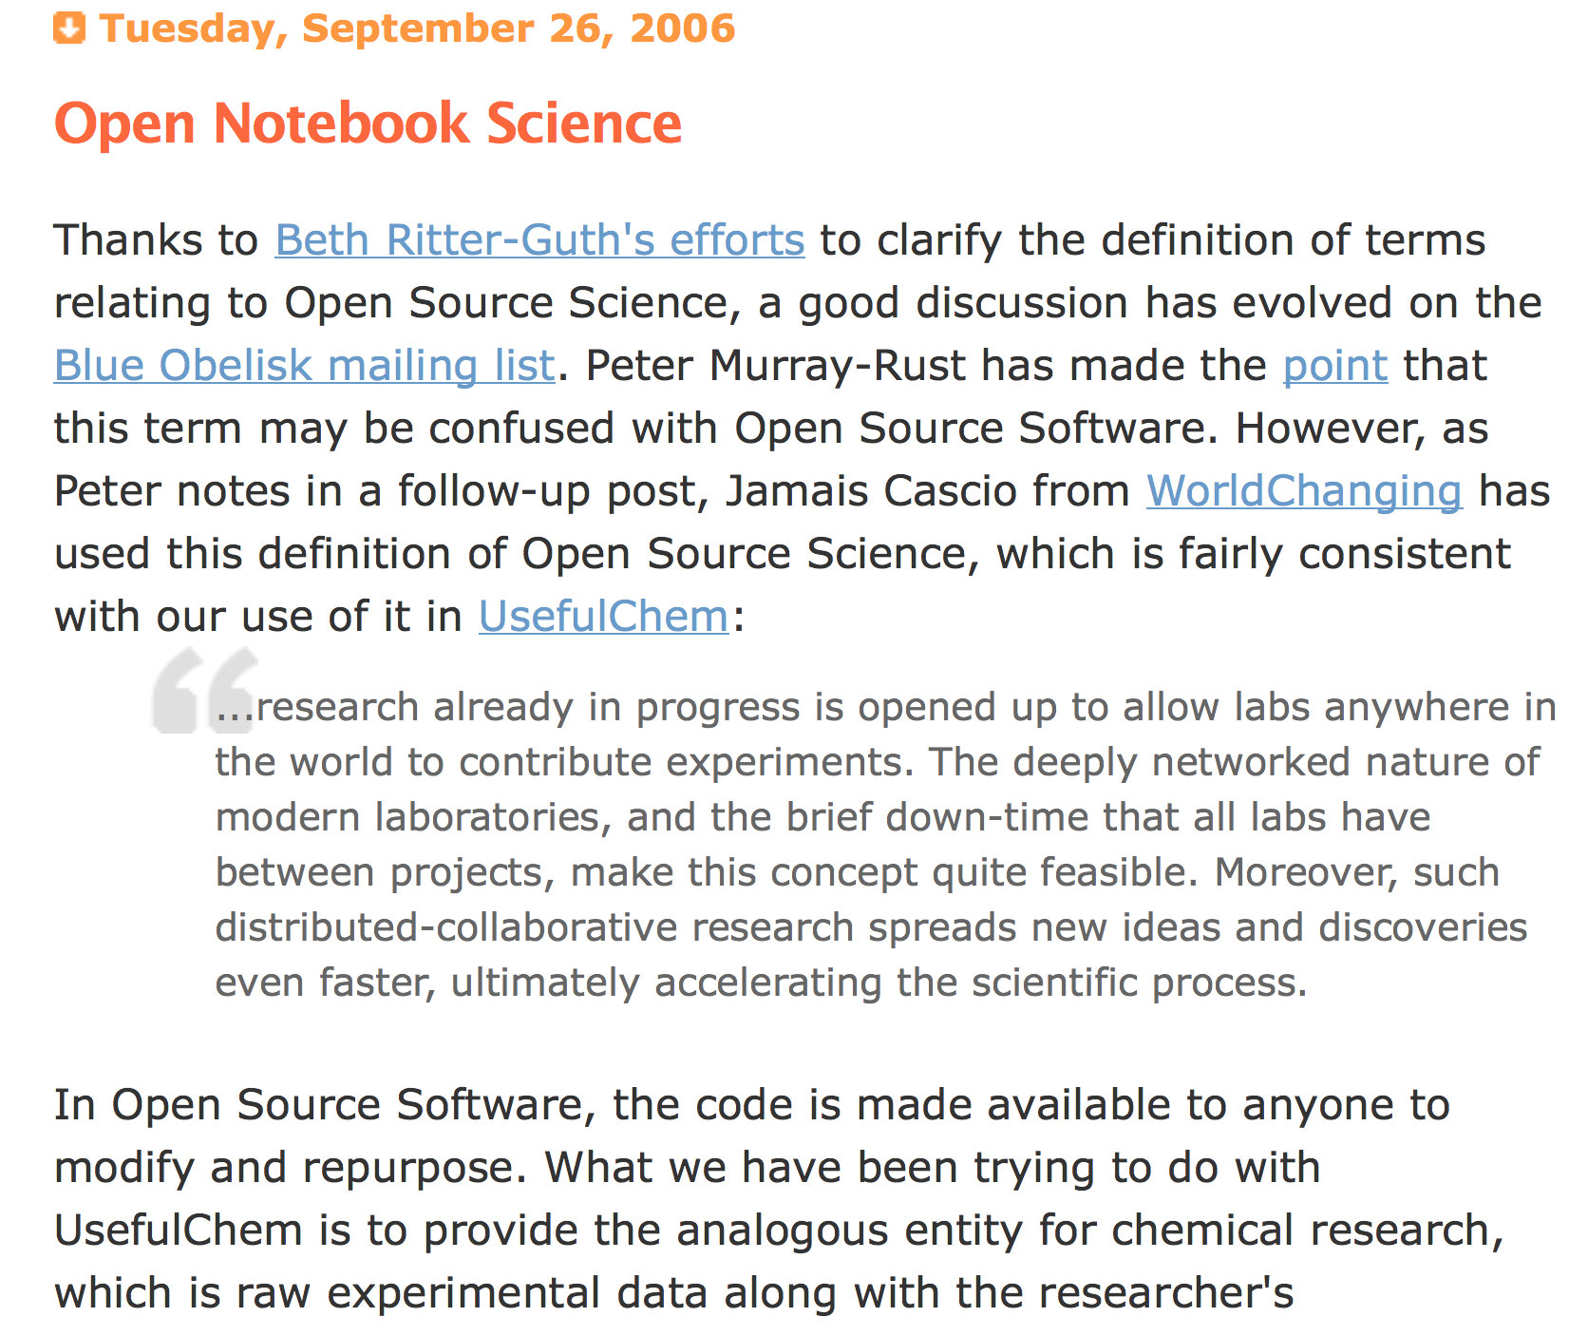

Slide 44
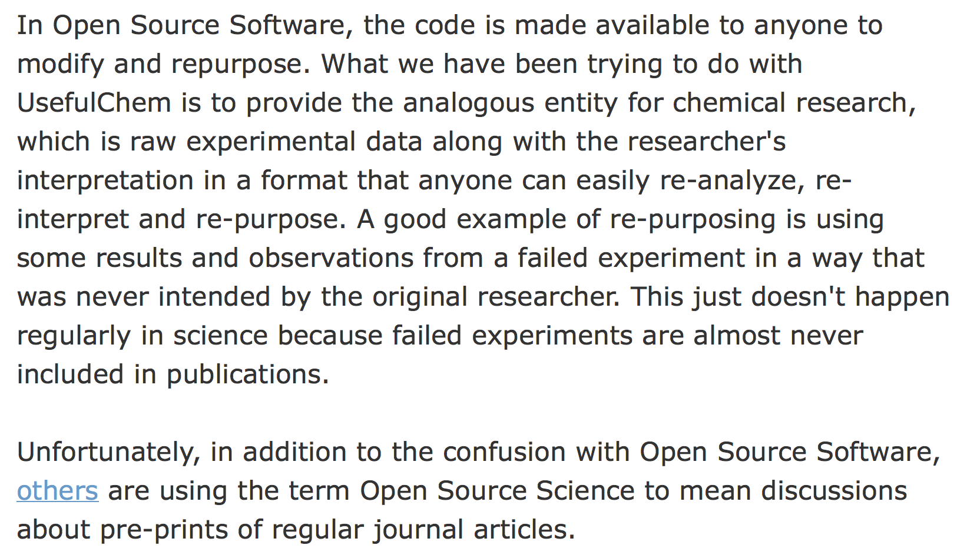
Open Source software inspires Open Science
Jean-Claude Bradley 2006

Slide 45
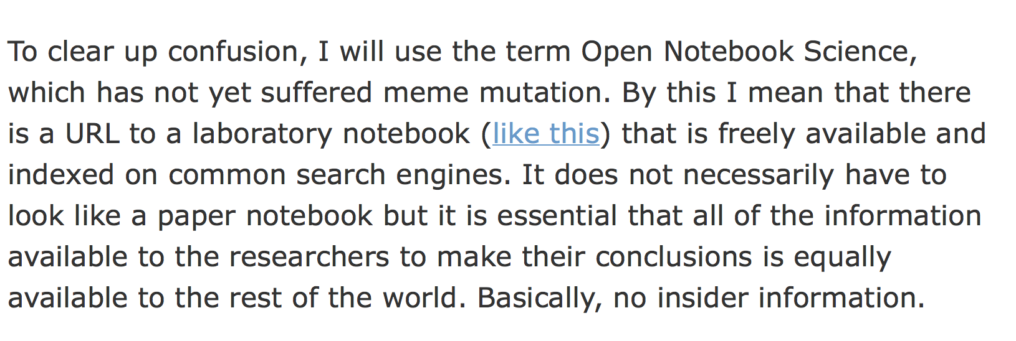
Open Notebook Science, ONS
Jean-Claude Bradley 2006

Slide 46
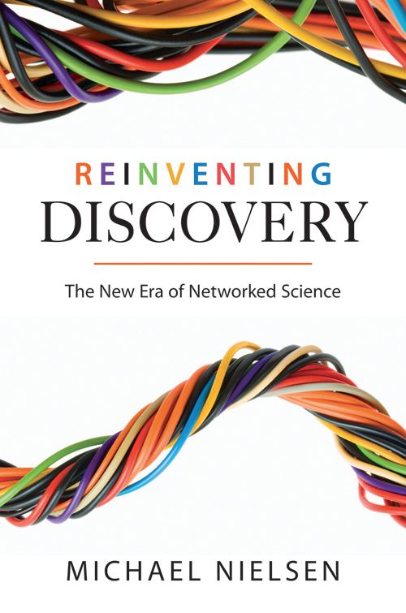

http://en.wikipedia.org/wiki/Reinventing_Discovery
http://michaelnielsen.org/blog/reinventing-discovery/

Slide 47
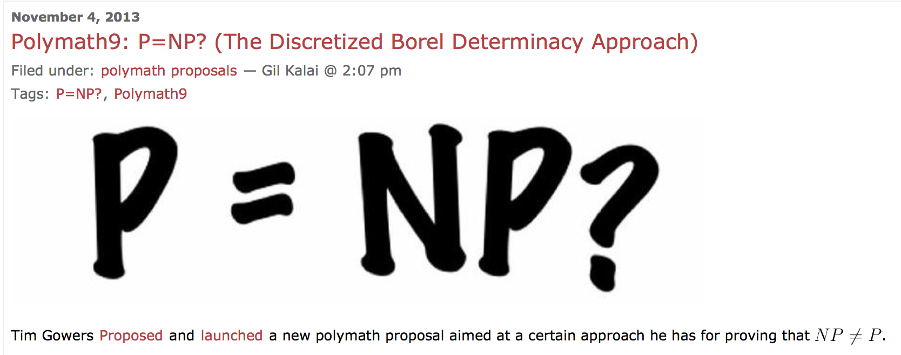
The Polymath project
Tim Gowers and the world
http://polymathprojects.org/2013/11/04/polymath9-pnp/#comments
http://gowers.wordpress.com/2013/11/03/dbd1-initial-post/

Slide 48
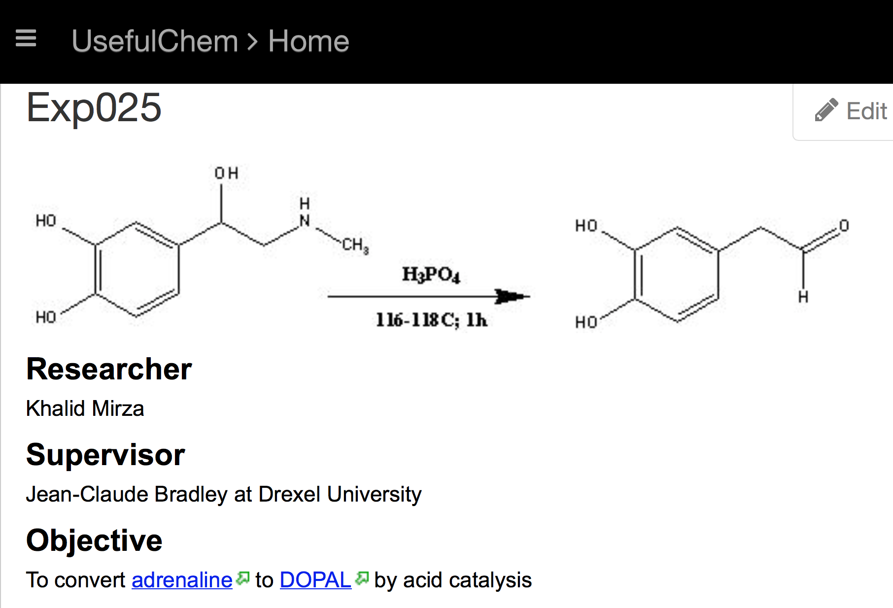
Jean-Claude Bradley 2006

Slide 49
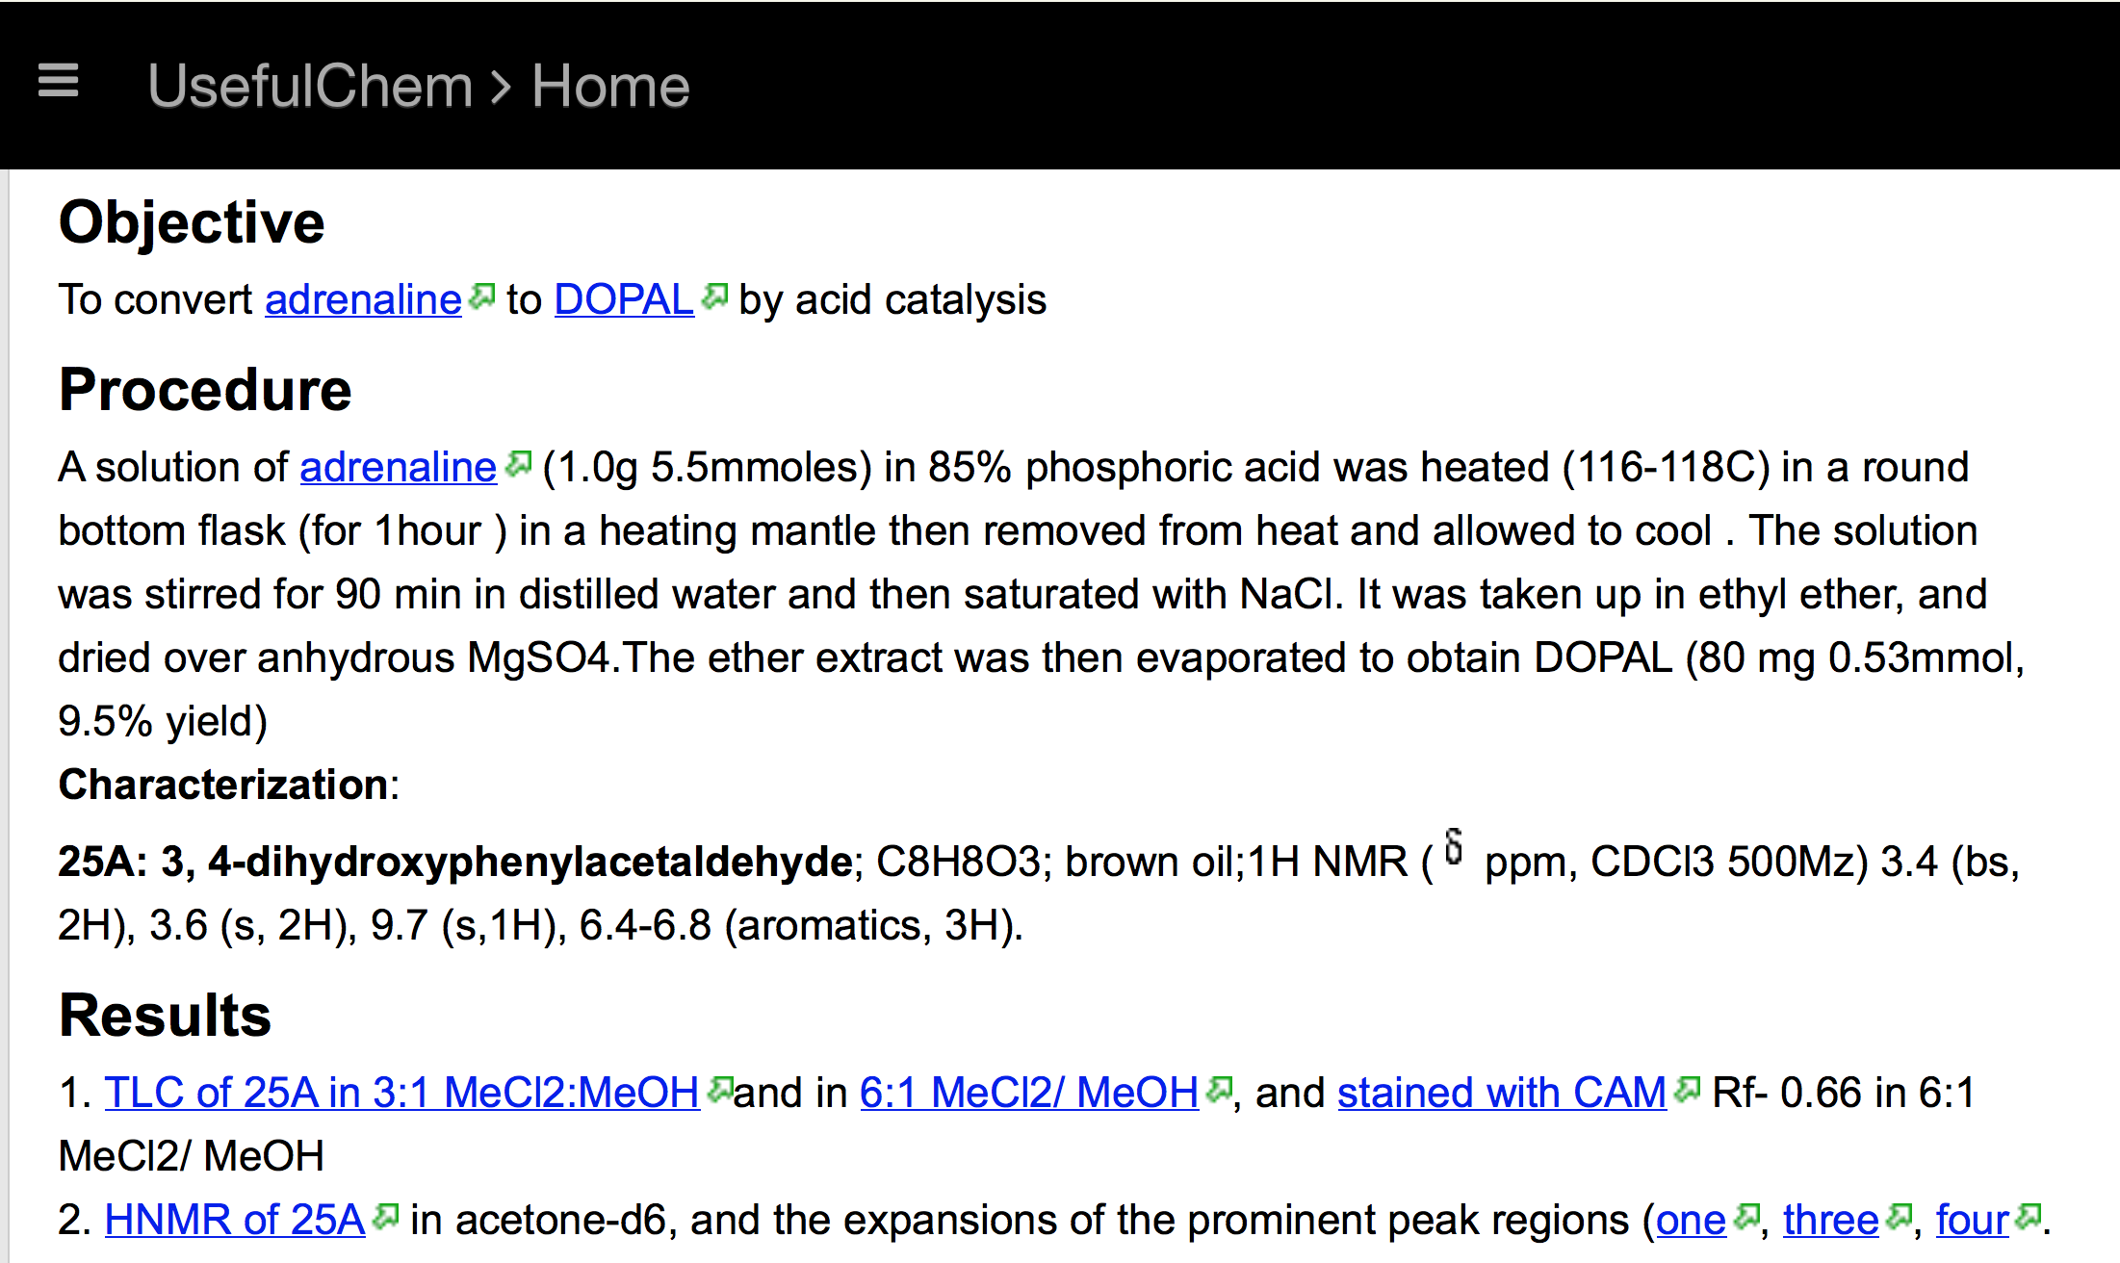
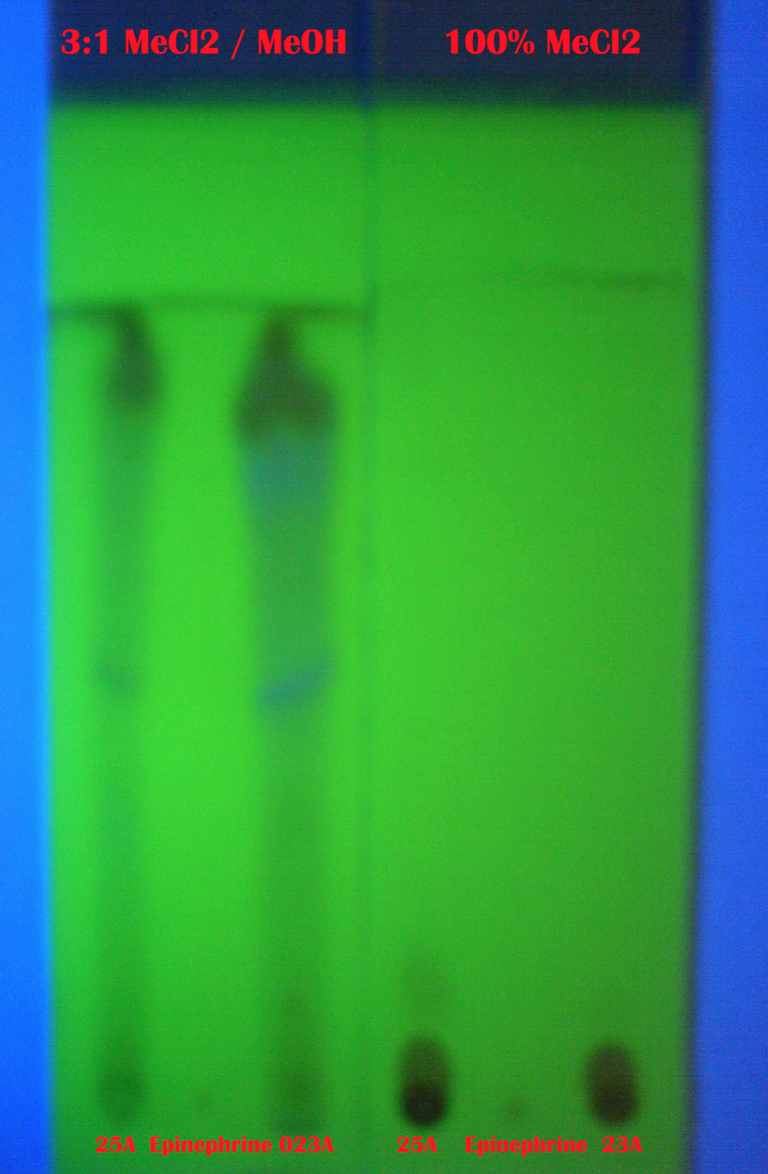
Jean-Claude Bradley 2006

Slide 50
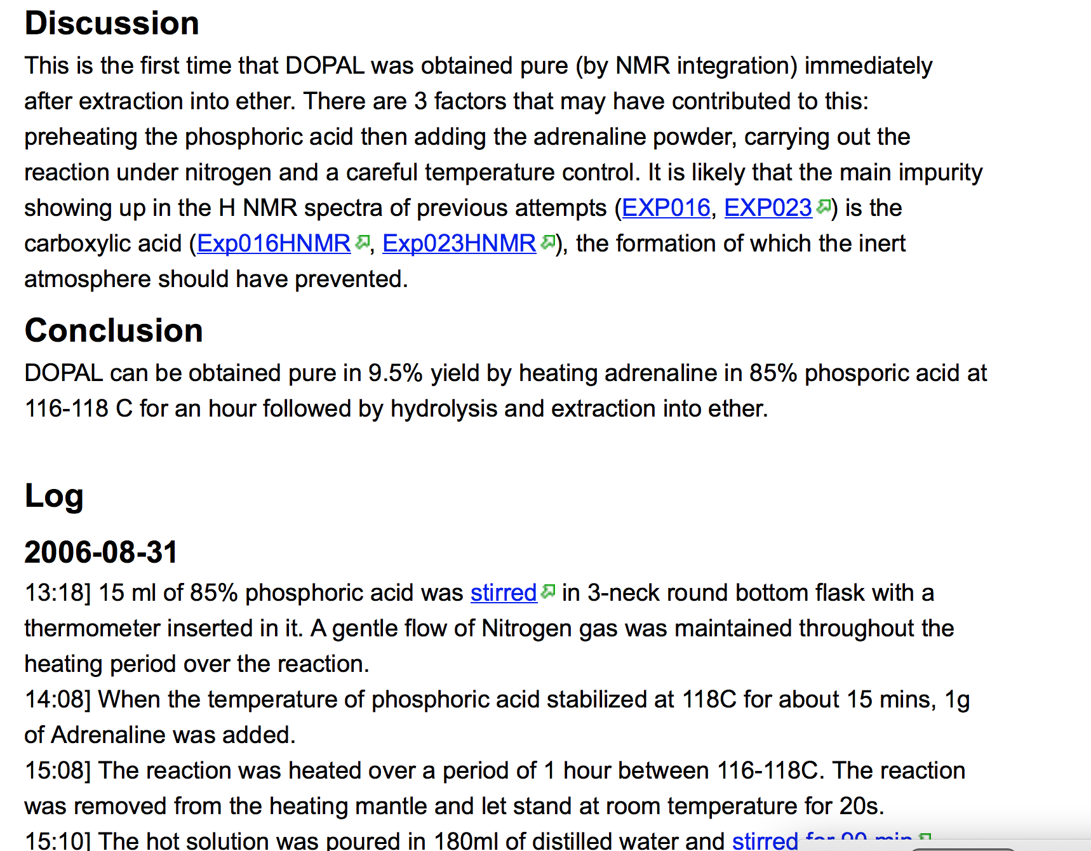
Jean-Claude Bradley 2006

Slide 51
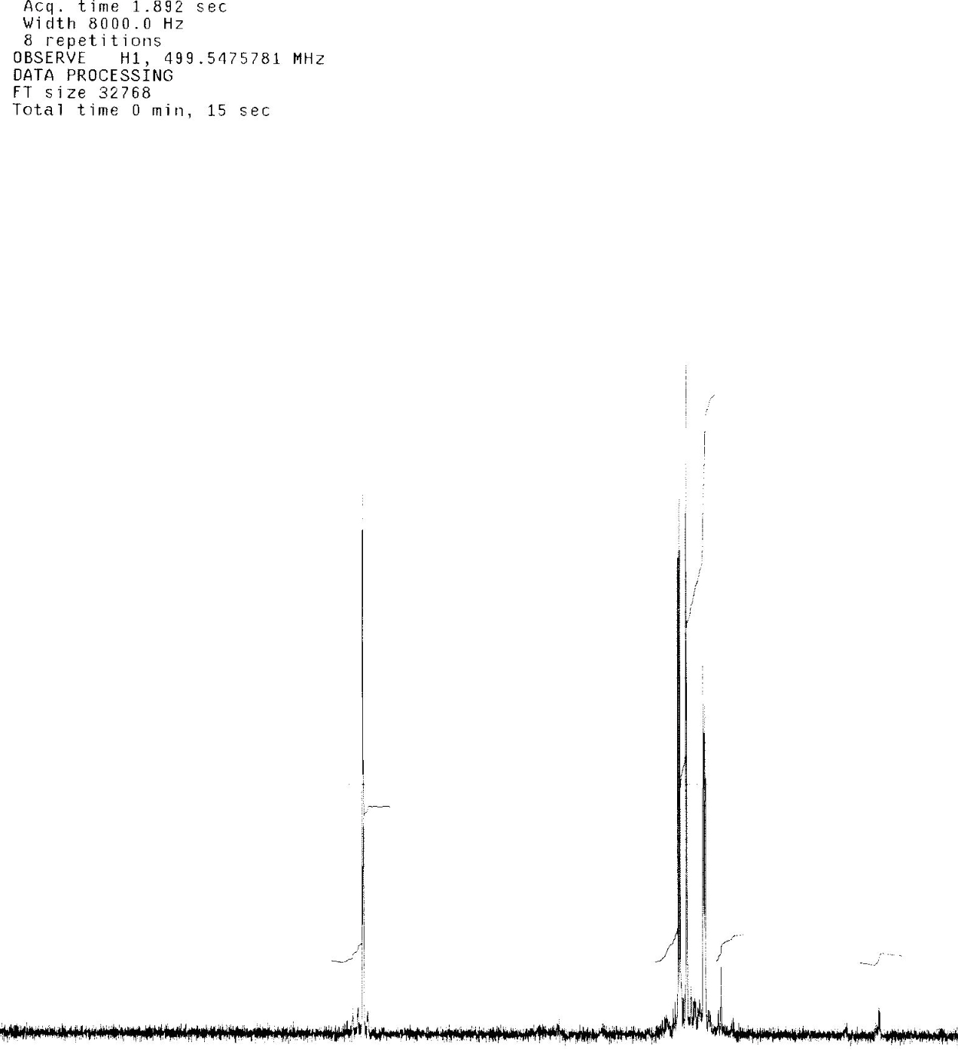
Jean-Claude Bradley 2006
And spectra were included as well

Slide 52
Open Notebook Science
TOOLS
Open engineered
repository
validate
DATA
INSTRUMENT
merge
knowledge
DATA
calibrate
CC-BY
MODEL
CODE
Machines and humans
Working together
World
community
Problems are solved communally;
Nothing is needlessly duplicated; “publication“ is continuous

